Slide 1

PRESENTATION ON FINAL REPORT PHONE MANAGEMENT SYSTEM
SANJINA RAI
BICT| 1st Semester
Matrix id: C30105220028

Slide 2
INTRODUCTION
Phonebook Management System is designed in ‘C’ language which allows user to perform some basic phonebook operations in your mobile phone. The basic functions of this projects include listing record, adding person, searching person details, removing contact details, updating records or deleting all the records.

Slide 3
PURPOSE
The main objective of this project is to develop an “Phonebook contact” application using C programming. It aims to help user to store complete information under single contact number. This program has options to storage, deletion and modification of entered contact.

Slide 4
PROBLEMS
Difficult to store more contacts
Difficult to store contacts with two or more contact numbers

Slide 5
FEATURES
Login
Implement of control statements, function, string, structure and file handling
List, add, search, modify, remove, update and delete contact

Slide 6
ALGORITHM
Steps | Algorithm
Step 1 | Start
Step 2 | Welcome To My Phone Book
Step 3 | Choose option
Step 4 | If choose=1 then go to list record
Step 5 | Else if choose=2 then go to add person
Step 6 | Else if choose=3 then go to search person detail
Step 7 | Else if choose=4 then go to remove person
Step 8 | Else if choose=5 then go to update person
Step 9 | Else if choose=6 then go to delete all content
Step 10 | Else go to exit phonebook
Step 11 | End

Slide 7
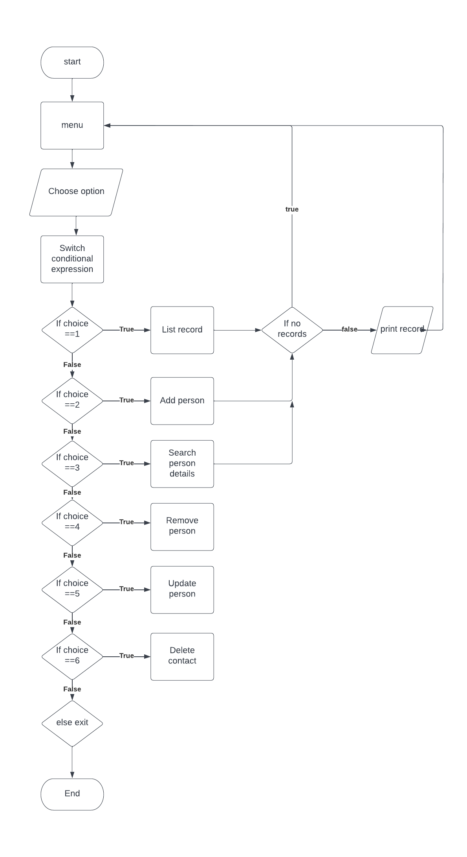
FLOWCHART

Slide 8
OVERVIEW
Let us see the demonstration of the system.

Slide 9
CONCLUSION
This system is certain to store and provide all the information under a single contact number. The main menu in this application contains the function to modify and delete the entered contact number.

